Slide 1
Course Notes
Chapter Ten
Sorting Algorithms
Department of Computer Science
The University of Texas – Pan American
Spring 2004

Slide 2
Chapter Objectives
Learn the various sorting algorithms
Explore how to implement the selection, insertion, quick, merge, and heap sorting algorithms
Discover how the sorting algorithms discussed in this chapter perform

Slide 3
Selection Sort
Sorts list by
  Finding smallest (or equivalently largest) element in the list
  Moving it to the beginning (or end) of the
  list by swapping it with element in beginning (or end) position

Slide 4
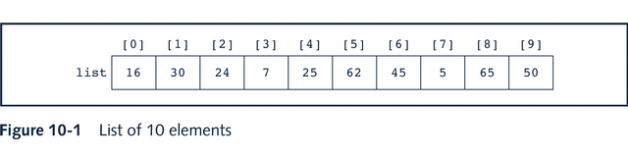
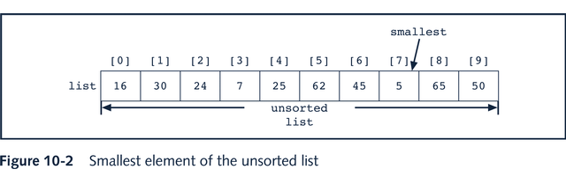
Selection Sort Example: Array-Based Lists

Slide 5
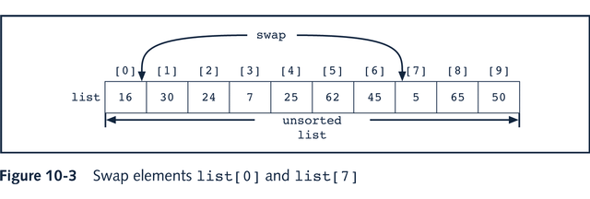
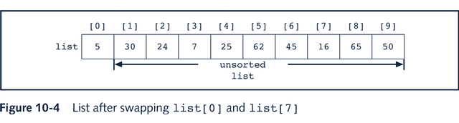
Selection Sort Example: Array-Based Lists

Slide 6
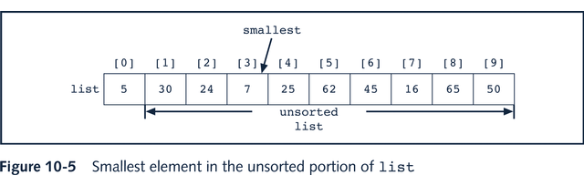
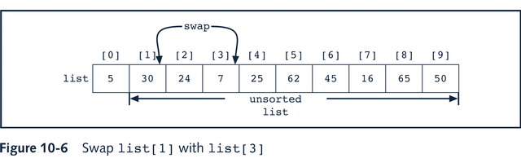
Selection Sort Example: Array-Based Lists

Slide 7
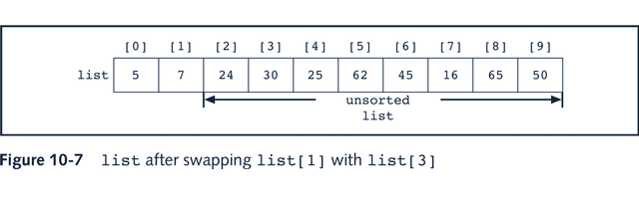
Selection Sort Example: Array-Based Lists

Slide 8
class orderedArrayListType
template<class elemType>
class orderedArrayListType:
public arrayListType<elemType>
{
public:
binarySearch(const elemType& item);
void selectionSort();
void insertionSort();
orderedArrayListType(int size = 100);
private:
int minLocation(int first, int last);
int swap(int first, int second);
};

Slide 9
Smallest Element in List
template<class elemType>
int orderedArrayListType<elemType>::minLocation
(int first, int last)
{
int loc, minIndex;
minIndex = first;
for(loc = first + 1; loc <= last; loc++)
if(list[loc] < list[minIndex])
minIndex = loc;
return minIndex;
}

Slide 10
Swap Two Elements in List
template<class elemType>
void orderedArrayListType<elemType>::swap
(int first, int second)
{
elemType temp;
temp = list[first];
list[first] = list[second];
list[second] = temp;
}

Slide 11
Selection Sort Function
template<class elemType>
void orderedArrayListType<elemType>::selectionSort()
{
int loc, minIndex;
for(loc = 0; loc < length - 1; loc++)
{
minIndex = minLocation(loc, length - 1);
swap(loc, minIndex);
}
}

Slide 12
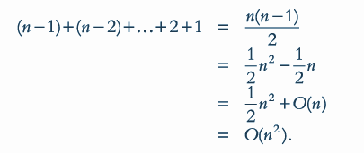
Analysis: Selection Sort
By analyzing the number of key comparisons, we can
see that selection sort is an O(n²) algorithm

Slide 13
Insertion Sort
Reduces number of key comparisons made in selection sort
Can be applied to both arrays and linked lists
Sorts list by
  Finding first unsorted element in list
  Moving it to its proper position

Slide 14
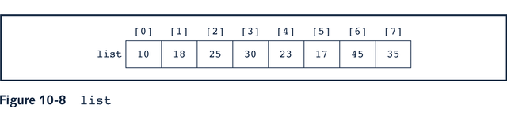
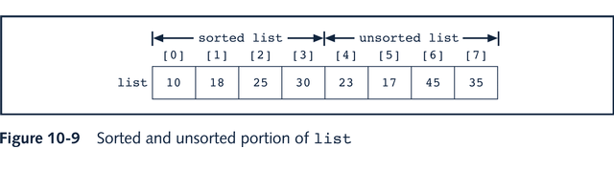
Insertion Sort: Array-Based Lists

Slide 15
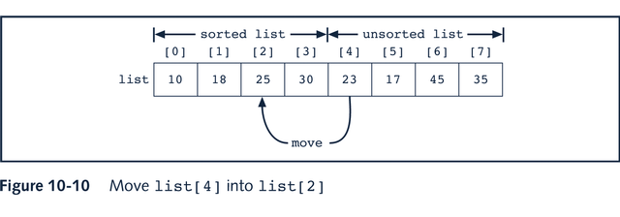
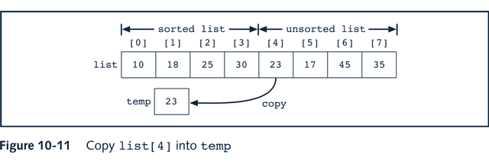
Insertion Sort: Array-Based Lists

Slide 16
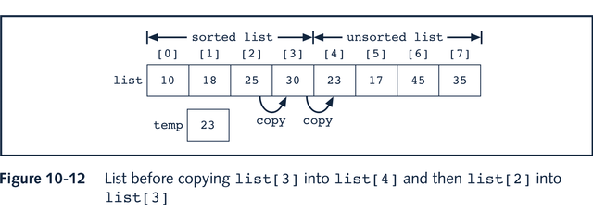
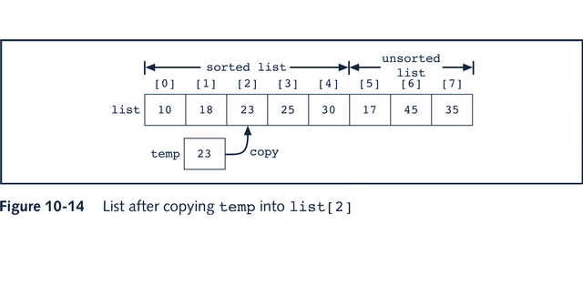
Insertion Sort: Array-Based Lists

Slide 17
Insertion Sort: Array-Based Lists
template<class elemType>
void orderedArrayListType<elemType>::insertionSort()
{
int firstOutOfOrder, location;
elemType temp;
for(firstOutOfOrder = 1; firstOutOfOrder < length;
firstOutOfOrder++)
if(list[firstOutOfOrder] < list[firstOutOfOrder - 1])
{
temp = list[firstOutOfOrder];
location = firstOutOfOrder;
do
{ list[location] = list[location - 1];
location--;
}while(location > 0 && list[location - 1] > temp);
list[location] = temp;
}
}//end insertionSort

Slide 18
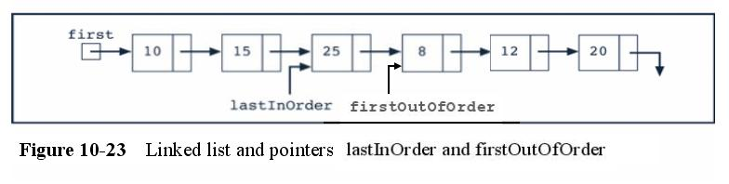
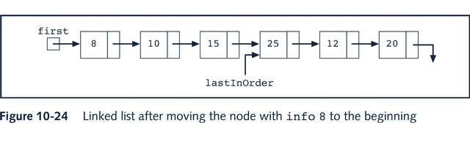
Insertion Sort: Linked List-Based List

Slide 19
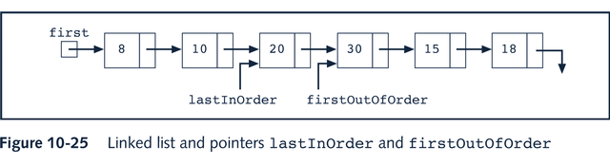
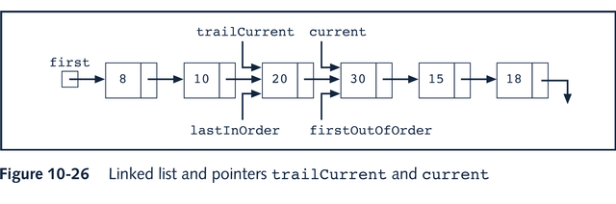
Insertion Sort: Linked List-Based List

Slide 20
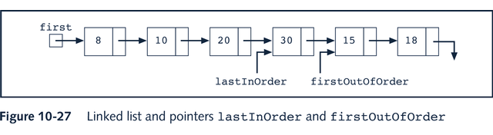
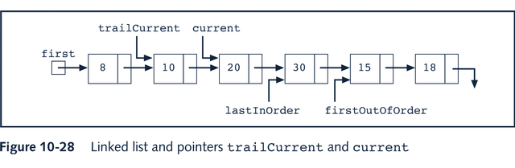
Insertion Sort: Linked List-Based List

Slide 21
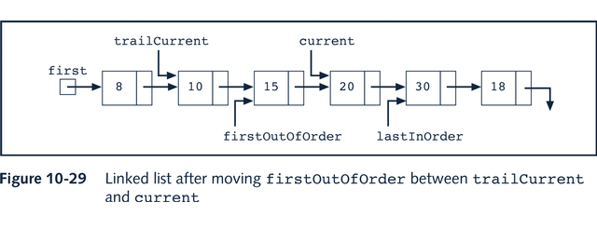
Insertion Sort: Linked List-Based List
linkedInsertionSort() function on p. 577

Slide 22
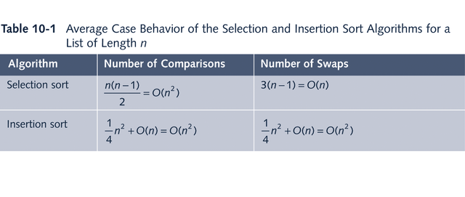

Analysis: Insertion Sort

Slide 23
Lower Bound on Comparison-Based Sort Algorithms
Trace execution of comparison-based algorithm by using graph called comparison tree
Let L be a list of n distinct elements, where n > 0. For any j and k, where 1 = j, k = n, either L[j] < L[k] or L[j] > L[k]
Each comparison of the keys has two outcomes; comparison tree is a binary tree
Each comparison is a circle, called a node
Node is labeled as j:k, representing comparison of L[j] with L[k]
If L[j] < L[k], follow the left branch; otherwise, follow the right branch

Slide 24
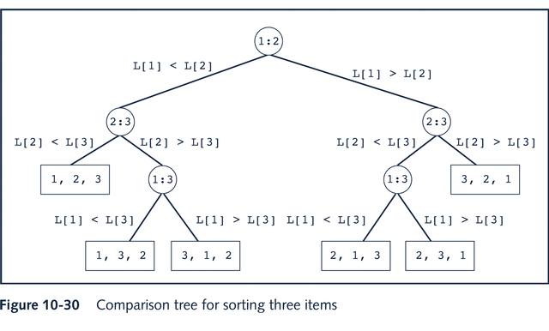
Lower Bound on Comparison-Based Sort Algorithms

Slide 25
Lower Bound on Comparison-Based Sort Algorithms
Top node in the figure is the root node
Straight line that connects the two nodes is called a branch
A sequence of branches from a node, x, to another node, y, is called a path from x to y
Rectangle, called a leaf, represents the final ordering of the nodes
Theorem: Let L be a list of n distinct elements. Any sorting algorithm that sorts L by comparison of the keys only, in its worst case, makes at least O(n*log₂n) key comparisons

Slide 26
Quick Sort
Recursive algorithm
Uses the divide-and-conquer technique to sort a list
List is partitioned into two sublists, and the two sublists are then sorted and combined into one list in such a way so that the combined list is sorted

Slide 27
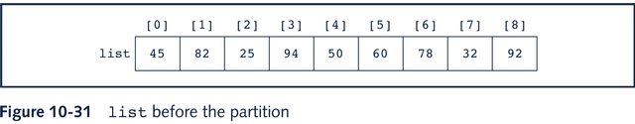
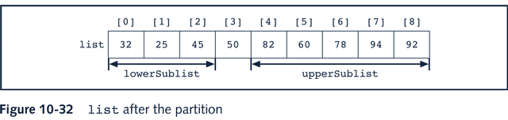
Quick Sort: Array-Based Lists

Slide 28
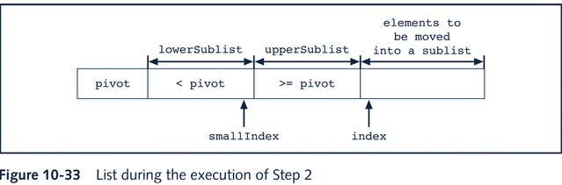
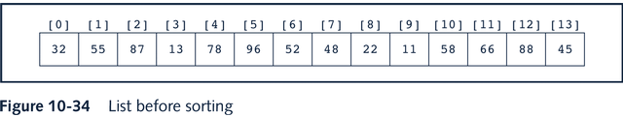
Quick Sort: Array-Based Lists

Slide 29
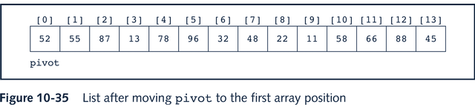
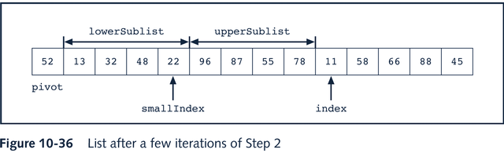
Quick Sort: Array-Based Lists

Slide 30
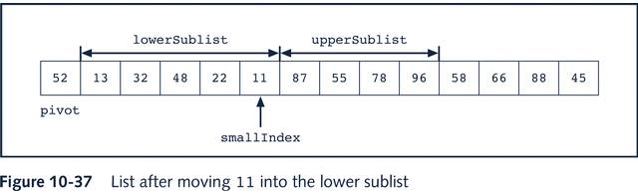
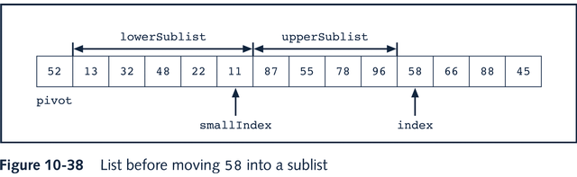
Quick Sort: Array-Based Lists

Slide 31
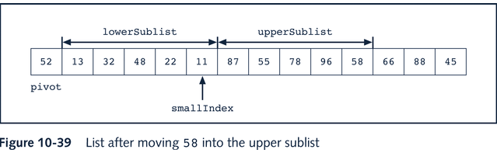
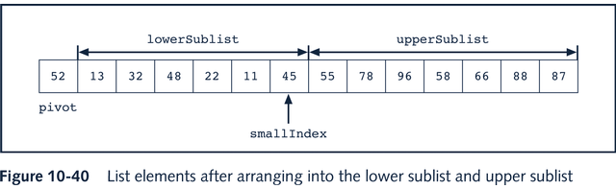
Quick Sort: Array-Based Lists

Slide 32
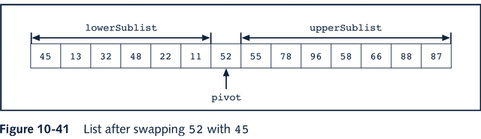
Quick Sort: Array-Based Lists

Slide 33
Quick Sort: Array-Based Lists
template<class elemType>
int orderedArrayListType<elemType>::partition(int first, int last)
{
elemType pivot;
int index, smallIndex;
swap(first, (first + last)/2);
pivot = list[first];
smallIndex = first;
for(index = first + 1; index <= last; index++)
if(list[index] < pivot)
{
smallIndex++;
swap(smallIndex, index);
}
swap(first, smallIndex);
return smallIndex;
}

Slide 34
Quick Sort: Array-Based Lists
template<class elemType>
void orderedArrayListType<elemType>::swap(int first,int second)
{
elemType temp;
temp = list[first];
list[first] = list[second];
list[second] = temp;
} //end swap

Slide 35
Quick Sort: Array-Based Lists
template<class elemType>
void orderedArrayListType<elemType>::recQuickSort(int first, int last)
{
int pivotLocation;
if(first <last)
{
pivotLocation = partition(first, last);
recQuickSort(first, pivotLocation - 1);
recQuickSort(pivotLocation + 1, last);
}
} //end recQuickSort
template<class elemType>
void orderedArrayListType<elemType>::quickSort()
{
recQuickSort(0, length - 1);
}//end quickSort

Slide 36
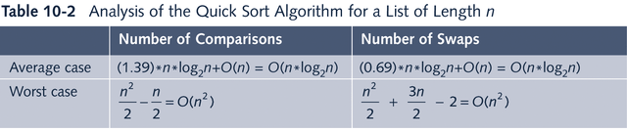
Quick Sort: Array-Based Lists

Slide 37
Merge Sort
Uses the divide-and-conquer technique to sort a list
Merge sort algorithm also partitions the list into two sublists, sorts the sublists, and then combines the sorted sublists into one sorted list

Slide 38
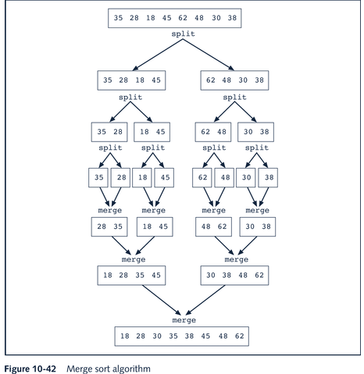
Merge Sort Algorithm

Slide 39
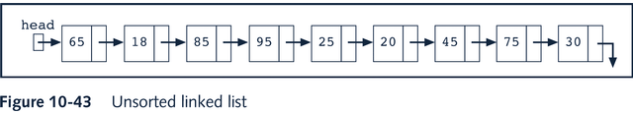
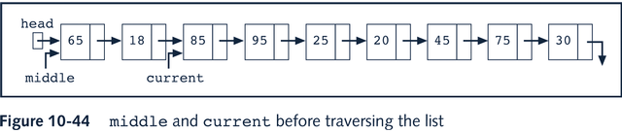
Divide

Slide 40
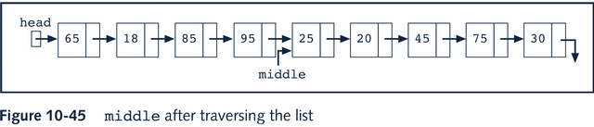
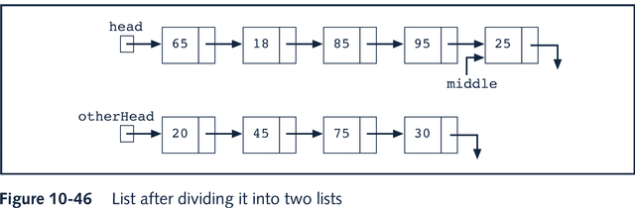
Divide (pp.590-591)

Slide 41
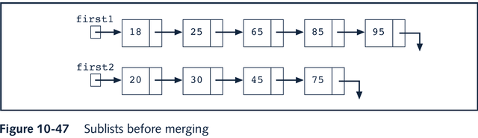
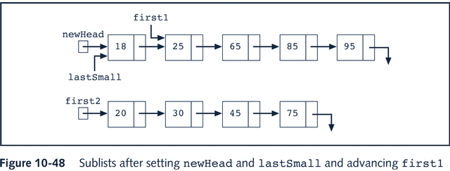
Merge

Slide 42
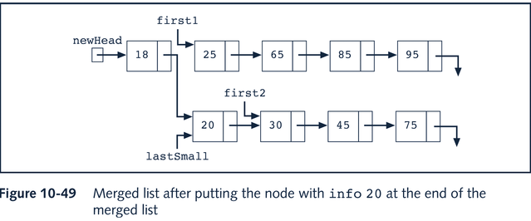
Merge (pp.593-594)

Slide 43
Merge (pp.593-594)
The function to divide a linked list into two separate lists
void divideList(nodeType* first1, nodeType* &first2)
{
nodeType *middle, *current;
if(first1 == NULL) first2 = NULL;
else
if (first1->link == NULL) first2 = NULL;
else {
middle = first1;
current = first1->link;
if (current != NULL) current = current->link;
while (current != NULL)
{ middle = middle->link;
current = current->link;
if (current != NULL) current = current->link;
}
first2 = middle->link;
middle->link = NULL;
}
}

Slide 44
Merge (pp.593-594)
The function to merge two linked lists into one list
nodeType* mergeList(nodeType* first1, nodeType* first2)
{
nodeType *newHead = NULL, *last;
while (first1 != NULL && first2 != NULL)
{ if (first1->info < first2->info)
{ if (newHead == NULL) newHead = first1;
else last->link = first1;
last = first1;
first1 = first1->link;
} else {
{ if (newHead == NULL) newHead = first2;
else last->link = first2;
last = first2;
first2 = first2->link;
}
}
if(first1 == NULL)
{ if (newHead == NULL) newHead = first2;
else last>link = first2;
} else {
if (newHead == NULL) newHead = first1;
else last>link = first1;
}
return newHead;
}

Slide 45
Merge (pp.593-594)
The recursive merge sort function
void recMergeSort(nodeType* &head)
{
nodeType *otherHead;
if(head != NULL)
if (head->link != NULL)
{
divideList(head, otherHead);
recMergeSort(head);
recMergeSort(otherHead);
head = mergeList(head, otherHead);
}
}
To sort a linked list with a head pointer first
void mergeSort()
{
recMergeSort(first);
}

Slide 46
Analysis of Merge Sort
Suppose that L is a list of n elements, where n > 0.
Let A(n) denote the number of key comparisons in
the average case, and W(n) denote the number of key
comparisons in the worst case to sort L. It can be
shown that:
A(n) = n*log₂n – 1.26n = O(n*log₂n)
W(n) = n*log₂n – (n–1) = O(n*log₂n)

Slide 47
Heap Sort: Array-Based Lists
Definition:
A heap is a list in which each element contains a key, such that the key in the element at position k in the list is at least as large as the key in the element at position 2k + 1 (if it exists), and 2k + 2 (if it exists)

Slide 48
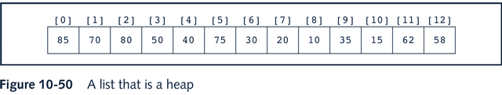
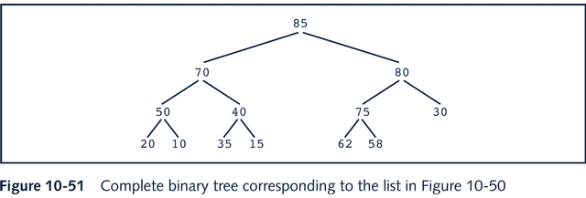
Heap Sort: Array-Based Lists

Slide 49
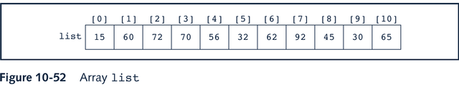
Heap Sort: Array-Based Lists
Build Heap
The above list is no a heap. Let’s see how to build it into a heap

Slide 50
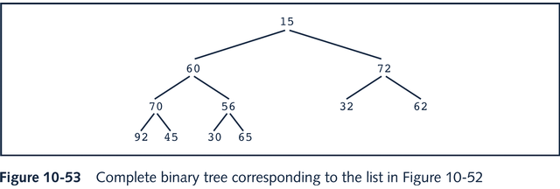
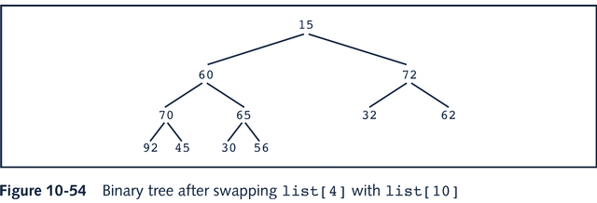
Heap Sort: Array-Based Lists

Slide 51
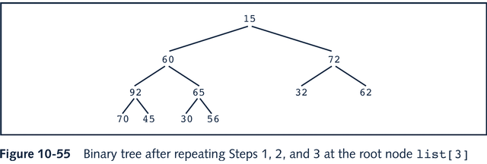
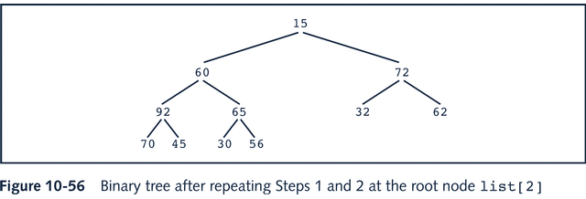
Heap Sort: Array-Based Lists

Slide 52


Heap Sort: Array-Based Lists

Slide 53


Heap Sort: Array-Based Lists

Slide 54

Heap Sort: Array-Based Lists
Now, the list becomes a heap

Slide 55
Heap Sort: Array-Based Lists
Template<class Type>
void orderedArrayListType<Type>::heapify(int low, int high)
{
Type temp = list[low];
int largerIndex = 2 * low + 1;
while (largerIndex <= high) {
if (largerIndex < high &&
list[largerIndex] < list[largerIndex + 1])
largerIndex++;
if (temp > list[largerIndex]) break;
else {
list[low] = list[largerIndex];
low = largerIndex;
largerIndex = 2 * low + 1;
}
}
list[low] = temp;
}

Slide 56
Heap Sort: Array-Based Lists
Template<class Type>
void orderedArrayListType<Type>::buildHeap()
{
for (int index = length/2 – 1; index >= 0; index--)
heapify(index, length-1);
}
Template<class Type>
void orderedArrayListType<Type>::heapSort()
{
buildHeap();
Type temp;
for (int last = length – 1; last >= 0; last--) {
temp = list[last];
list[last] = list[0];
list[0] = temp;
heapify(0, last-1);
}
}

Slide 57
Heap Sort
Algorithm Analysis:
On average, the number of comparisons made by the heap sort algorithm to sort the list L is of O(n*log n)

